Slide 1
CS 31006: Computer Networks – The Data Link Layer

Slide 2
The Data Link Layer
Application
Transport
Logical Link Control
Network
Medium Access Control
Data Link
Physical

Slide 3
Every Layer Adds Up Their Own Services
Addressing
Routing
Network
Framing and Access Control
Switching
Flow Control
Error Control
Data Link
MAC
LLC
Analog Communication
AD/DA Conversion
Modulation
Coding
Physical

Slide 4
Data Link Layer Switching
Connect multiple LANs together
Do not send traffic onto ports where it is not needed
Each LAN can run at full speed

Slide 5
Data Link Layer Switching
Data link layer switches (sometime called as bridge – the old name) should be completely transparent
Plug and Play – no address change
The operations of existing LANs should not be affected
The functionality of the devices should remain same even if they are part of the switched LAN
Easy to move stations over a switched LAN similar to a normal LAN
Step 1: Learning switches (backward learning algorithm) to stop traffic being sent where it is not needed
Step 2: Spanning tree algorithm to break loops

Slide 6
Learning Switches / Bridges
The old topology – not used now a days
This topology is mostly used
- Single machine at every switch port
Collision Domain - 2
Collision Domain - 1

Slide 7
Learning Switches / Bridges
Switch operates in promiscuous mode
Accepts every frame transmitted by stations attach to each of its ports
The switch decides whether to forward or discard each frame, and if forward which port to output the frame
Maintain a table (Output Port, MAC address) that maps at which port what machine / machines are connected
When the switches are first plugged in, the table is empty

Slide 8
Learning Switches/ Bridges
Use flooding at the initialization – every incoming frame for an unknown destination is output on all the ports of the switch, except the one from where the frame has arrived
Every network interface (machine) connected on that receives that frame
Decode the frame
Check the destination MAC address at the frame header
If the address matches, accept the frame
Else, drop the frame
The switches starts learning about the (Output Port, MAC address) at this phase – called the backward learning

Slide 9
Learning Switches / Bridges
For every incoming frame at a port, check the source MAC address
If the destination MAC is that one, then the frame needs to output at the same port
The (Output port, MAC address) table is populated gradually by applying this backward learning
Source = MAC₁ Destination = MAC₂
Port A

Slide 10
Learning Switches / Bridges
For every incoming frame at a port, check the source MAC address
If the destination MAC is that one, then the frame needs to output at the same port
The (Output port, MAC address) table is populated gradually by applying this backward learning
Source = MAC₁ Destination = MAC_{x}
Port A
Port A, MAC₁

Slide 11
Learning Switches / Bridges
For every incoming frame at a port, check the source MAC address
If the destination MAC is that one, then the frame needs to output at the same port
The (Output port, MAC address) table is populated gradually by applying this backward learning
Delete old entries if not used for some time
Port A
Source = MAC_{x} Destination = MAC₁
Port A, MAC₁

Slide 12
Learning Switches / Bridges – The Rules / Mechanism
If the port for the destination address is the same as the source port, discard the frame
If the port for the destination address and the source port are different, forward the frame on the destination port
If the destination port is unknown, use flooding and send the frame on all ports except the source port
Source: Computer Network, Tanenbaum, Wetherall, The Medium Access Control Sublayer, Section 8

Slide 13
Cut Through Switching
The procedure needs to be very fast - switches are technically observing all the frames coming through
Implement in hardware
Once you start getting the bit stream, decode them immediately based on MAC frame structure
Observe the source MAC and destination MAC
Based on the destination MAC, if the switch does not need to forward the frame, do not process it further
Also known as wormhole routing

Slide 14
Spanning Tree Switches
To increase reliability, redundant links may be deployed between the switches
Creates loop in the topology
Note that for unknown destination, switches flood the frames
Such frames can loop within the LAN

Slide 15
Spanning Tree Switches
Construct a spanning tree across the switches
B1
B2
B5
B3
B4
B6

Slide 16
Spanning Tree Protocol (STP)
Switches run a distributed algorithm to build the spanning tree
Each switch periodically broadcast a configuration message out all of its ports , processes the message it receives from other switches
Embedded in STP frames
To choose the root of the spanning tree, the switches include an identifier based on the MAC address in the configuration message, as well as the identifier they believe to be the root
The bridges choose the bridge with the lowest identifier to be the root

Slide 17
Spanning Tree Protocol (STP)
A tree of shortest paths from the root to every switch is constructed
Include the distance from the root in the configuration messages
Each switch remembers the shortest path it finds to the root
The switches then turn off ports that are not part of the shortest path
The algorithm continues to run to detect any changes in the topology and update the tree

Slide 18
Spanning Tree Protocol (STP)
Invented by Radia Perlman, 1985 (sometime called as “Mother of Internet”)
“I think that I shall never see A graph more lovely than a tree. A tree whose crucial property Is loop-free connectivity. A tree that must be sure to span So packets can reach every LAN. First, the root must be selected. By ID, it is elected. Least-cost paths from root are traced. In the tree, these paths are placed. A mesh is made by folks like me, Then bridges find a spanning tree.”
-Radia Perlman

Slide 19
Network Devices at Different Layers
Application Gateway
Application Layer
Transport Gateway
Transport Layer
Router
Network Layer
Bridge, Switch
Data Link Layer
Repeater, Hub
Physical Layer

Slide 20
Virtual LAN (VLAN)
LAN is a broadcast domain
Every frame is a broadcast to all the machines connected in a switch port
VLAN
Construct a broadcast domain even if they are not a part of the switch port – use VLAN ID
Logical segmentation
Better security, Ex. Design policy such that only the nodes in a VLAN can communicate with each other
Image Source: https://www.cisco.com

Slide 21
VLAN Support in 802.1Q

Slide 22
Error Detection and Correction
Bit errors can be introduced during transmission of the signal – more common for wireless networks
Add redundant information with the frame that is sent
Error detection: Include enough redundancy so that the receiver can separate out a correct frame and an erroneous frame (cannot identify the actual error)
Error correction: Include enough redundancy so that the receiver can correct errors up to some level (detect which bits are having an error)

Slide 23
Error Detecting Codes - Parity Bit
Include a single parity bit with the data.
The parity bit is chosen so that the number of 1 bits in the codeword is even (or odd, depending on the setup)
1101110011 is the data to transmit
Codeword is 11011100111 for even parity transmission
Can detect an odd numbers of bit errors – single bit error can be reliably detected
Difficult to detect for burst error

Slide 24
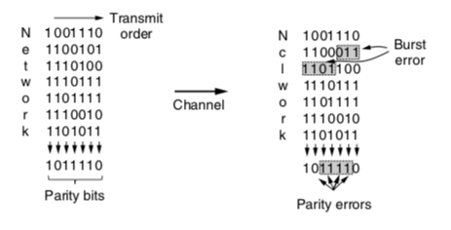
Error Detecting Codes – Interleaving Parity
Even parity
N parity bits are used for kN data bits
k bit errors will be reliably detected with at most one error per row
Source: Computer Network, Tanenbaum, Wetherall, The Data Link Layer, Section 2

Slide 25
Error Detecting Codes – Checksum
Let us look into the case for 16-bit Internet checksum
Divide the data bits into 16 bit words
Use 1’s complement arithmetic to compute the sum
Find out 1’s complement of the result - that’s the checksum

Slide 26
Example – 8 bit Checksum
Say, we want to transmit 1101110011001110
Two 8 bit words – 11011100 and 11001110
1’s complement addition - 00111100
1’s complement of the results – 11000011 – that’s the checksum
More rigorous than parity check – two bit flipped remains undetected in parity check, but may be detected in checksum

Slide 27
Error Detection Code – Cyclic Redundancy Check (CRC)
Also known as polynomial code – treat bit stream as a representation of polynomials with coefficient 0 and 1
For example, 1011001 can be treated as 1.x⁶ +0.x⁵ +1.x⁴ +1.x³ +0.x² +0.x¹ +1.x⁰, which is equivalent to x⁶+ x⁴+ x³+1
The sender and the receiver must agreed upon a generator polynomial G(x)
Both the high and the low order bits for the generator polynomial must be 1
To compute CRC for a polynomial M(x) corresponds to a frame, the number of bits in the frame must be longer than the generator polynomial

Slide 28
Error Detection Code – Cyclic Redundancy Check (CRC)
Append CRC at the end of the frame, such that the polynomial represented by the CRC included frame must be divisible by G(x)
The receiver checks whether the received frame is divisible by G(x), if no, then there has been a transmission error

Slide 29
Error Detection Code – Cyclic Redundancy Check (CRC)
Let r be the degree of G(x), append r zero bits to the low order end of the frame, so the frame contains m+r bits where m is the number of bits in the original frame. The polynomial corresponds to x^{r}M(x)
Divide the bit string corresponds to x^{r}M(x) by the bit string corresponding to G(x) using modulo 2 division
Subtract the remainder (which is always r bits or fewer) from the bit string corresponding to x^{r}M(x) using modulo 2 subtraction. The result is the checksum frame to be transmitted
Subtraction is equivalent to XOR in modulo 2 arithmetic

Slide 30
CRC – Example
A polynomial code with r check bits can detect all burst errors less than on equal to r
Source: http://computing.dcu.ie/~humphrys/Notes/Networks/data.polynomial.html

Slide 31
Forward Error Correction (FEC)
Let a frame consists of m data bits and r check bits
Block codes: The r check bits are computed solely as a function of the m data bits
Linear codes: The r check bits are computed as a linear function of the m data bits, example: XOR with modulo 2 arithmetic
Error correcting codes – the r check bits that are sent with the data bits for correcting a single or multiple bit errors during the transmission

Slide 32
Hamming Distance
The number of bit positions in which two codeword differs (Hamming, 1950)
Example
Codeword-1 11001101
Codeword-2 01001010
XOR 10000111
Hamming distance is 4
If two codewords are a Hamming distance d apart, it will require d single bit errors to convert one into another

Slide 33
Hamming Distance for Error Detection
Number of possible m bit data messages 2^{m}
Number of possible m+r codewords 2^{m+r} – all the codewords are not valid codewords
We can have 2^{m} different codewords corresponding to 2^{m} different messages
To detect d bit errors, we need to ensure that the Hamming distance between two valid codewords is d+1
d

Slide 34
Hamming Distance for Error Correction
We need to map every invalid codeword to a valid codeword
To correct d single-bit errors, the minimum Hamming distance between two codewords should be at least 2d+1
d
2d + 1
d

Slide 35
Hamming Distance for Error Correction - Example
Consider the four codewords
0000000000
0000011111
1111100000
1111111111
The hamming distance is 5 – we can correct single and double bit errors
If the received codeword is 1010100000, we can expect the original codeword be 1111100000
Say you have received 1010000000, and there are maximum three bit errors, guess the original codeword

Slide 36
Hamming Codes - Encoding
Say the data is 1000001
11 = 1 + 2 + 8
10 = 2 +8
9 = 1 + 8
7 = 1 + 2 + 4
6 = 2 + 4
5 = 1 + 4
3 = 1 + 2
P1 | P2 | M3 | P4 | M5 | M6 | M7 | P8 | M9 | M10 | M11
0 | 0 | 1 | 0 | 0 | 0 | 0 | 1 | 0 | 0 | 1
2^{x} positions are for parity bits, rest for data bits
Gives a code with Hamming distance of 3
One bit error can be corrected

Slide 37
Hamming Codes – Decoding with Single Bit Error
Single bit error in data bit
11 = 1 + 2 + 8
10 = 2 +8
9 = 1 + 8
7 = 1 + 2 + 4
6 = 2 + 4
5 = 1 + 4
3 = 1 + 2
P1 | P2 | M3 | P4 | M5 | M6 | M7 | P8 | M9 | M10 | M11
0 | 0 | 1 | 0 | 1 | 0 | 0 | 1 | 0 | 0 | 1
Check the parity bits
We can find out an error in M5

Slide 38
Hamming Codes – Decoding with Single Bit Error
Single bit error in parity bit
11 = 1 + 2 + 8
10 = 2 +8
9 = 1 + 8
7 = 1 + 2 + 4
6 = 2 + 4
5 = 1 + 4
3 = 1 + 2
P1 | P2 | M3 | P4 | M5 | M6 | M7 | P8 | M9 | M10 | M11
0 | 0 | 1 | 1 | 0 | 0 | 0 | 1 | 0 | 0 | 1
Check the parity bits
We can find out a mismatch at M7, M6 and M5
We can correct at most one bit error
P4 is the common parity bit – so the error is there

Slide 39
Framing
Identify a frame from the received bits
How do you you identify which part of the bit stream is a single frame?
Can you use a length field in the header?
00110101000100010

Slide 40
Flag bits at the Beginning of the Frame
Start frame delimiter (SFD) and end frame delimiter (EFD)
A special bit sequence indicating beginning of a frame
EFD is deprecated and is not used now a days
Ethernet SFD: 10101011
Preamble: Synchronize the sender and the receiver – sequence of 10101010

Slide 41
Ethernet Frame Structure

Slide 42
Byte Stuffing (PPPoE)
10101011 can also be a part of the payload
Solution: Insert a special escape byte (ESC) if the SFD is part of the data – used in Point to Point Protocol (PPP)
ESC can be part of the data as well – insert another ESC before the ESC
A
SFD
B
A
ESC
SFD
B
A
ESC
B
A
ESC
ESC
B

Slide 43
Bit Stuffing (HDLC)
Byte stuffing has the overhead of one byte per ESC character
Use bit stuffing instead of byte stuffing – implemented in High-level Data Link Control (HDLC) protocol
In HDLC, each frame begins and ends with 01111110 (called FLAG byte)
Six consecutive 1’s in the data can get confused with this FLAG byte
Stuff a 0 bit if there is 5 consecutive 1’s in the data bit – transmit 011111010 instead of 01111110

Slide 44
Bit Stuffing Example

Slide 45
The Channel Allocation Problem
Many of the times, the media is a broadcast media
A wireless Network
A Cellular Network

Slide 46
Static Channel Allocation
Frequency Division Multiple Access (FDMA):
Time Division Multiple Access (TDMA):

Slide 47
Dynamic Channel Allocation
Static Channel Allocation has multiple problems:
Resource wastage when the user is idle
Strong synchronization is necessary
Dynamically allocate channels to the end users whenever required – multiple access protocols
Probabilistic scheduling among devices or users - contention based systems
Schedule the nodes such that contention can be minimized

Slide 48
Multiple Access Protocol
Pure Aloha: Transmit the frame whenever you have one
Results in collision
The hub rebroadcast the frame ( works as an acknowledgement)
If the sender does not hear its frame within a timeout, retransmission the frame again
Slotted Aloha: Divide time into discrete interval called slots. Transmit the frame at the beginning of the next slot
The users need to agree on slot boundaries
Collision can still happen, retransmit after timeout
Doubles up the efficiency compared to pure Aloha – check the Tanenbaum book for details !
Best channel utilization with slotted aloha is 1/e (e=2.71828), approx. 36.7%

Slide 49
Carrier Sense Multiple Access (CSMA)
Physical carrier sensing (PCS): Sense the carrier to see whether there is any ongoing signal.
If PCS returns the channel to be idle, the station sends data
Otherwise wait until the channel becomes idle
If collision occurs, wait for random amount of time and repeat the process
We call this as 1-persistent CSMA

Slide 50
p-persistent CSMA
Divide the time to logical slots
When station is ready to send a frame, sense the channel (PCS)
If the channel is idle at the current slot, then transmit with probability p
With probability 1-p, target the next slot, and repeat the process
Non-persistent CSMA: If the channel is sensed busy through PCS, wait random amount of time, and then sense again

Slide 51
Collision in CSMA (CSMA/CD)
Two stations may sense the channel idle at the same time, and starts transmission
A collision can happen in the channel – detect the collision
Collision signal will differ from the normal signal
Random Back-off: Wait for random amount of time if a collision is detected
Binary Exponential Back-off: At n^{th} attempt, wait for time equivalent of random(0,2^{n}-1) slots

Slide 52
Collision Detection and its Impact over MAC Frame Length
Worst case collision detection time = 2 x propagation delay
To detect a collision, the minimum frame transmission time should be equal to 2 x propagation delay (eg. Minimum Ethernet frame size = 64 bytes)

Slide 53
Ethernet Performance - Contention Interval
Contention interval is the time when the channel bandwidth is not utilized due to collision
We need to estimate the probabilistic length of a contention interval

Slide 54
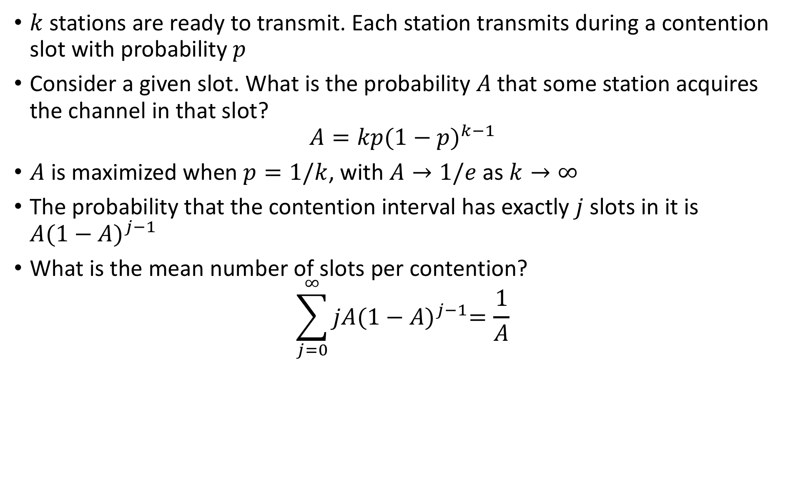
Ethernet Performance
$k$stations are ready to transmit. Each station transmits during a contention slot with probability $p$
Consider a given slot. What is the probability $A$that some station acquires the channel in that slot?
$$A=kp{(1−p)}^{k−1}$$
$A$ is maximized when $p=1/k$, with $A→1/e$ as $k→∞$
The probability that the contention interval has exactly $j$ slots in it is $A{(1−A)}^{j−1}$
What is the mean number of slots per contention?
$$\sum_{j=0}^{∞}{jA{(1−A)}^{j−1}=\frac{1}{A}}$$

Slide 55
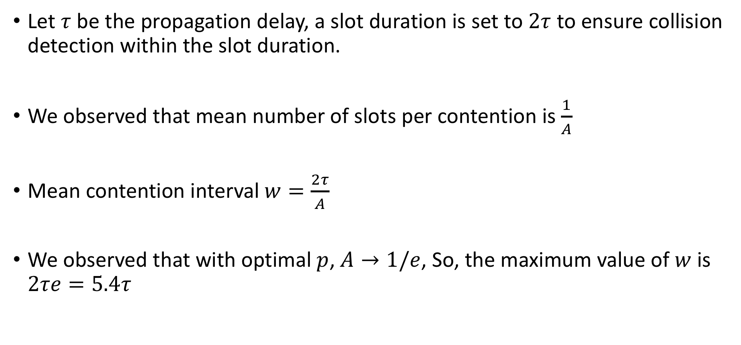
Ethernet Performance
Let $τ$ be the propagation delay, a slot duration is set to $2τ$ to ensure collision detection within the slot duration.
We observed that mean number of slots per contention is $\frac{1}{A}$
Mean contention interval $w=\frac{2τ}{A}$
We observed that with optimal $p$, $A→1/e$, So, the maximum value of $w$ is $2τe=5.4τ$

Slide 56
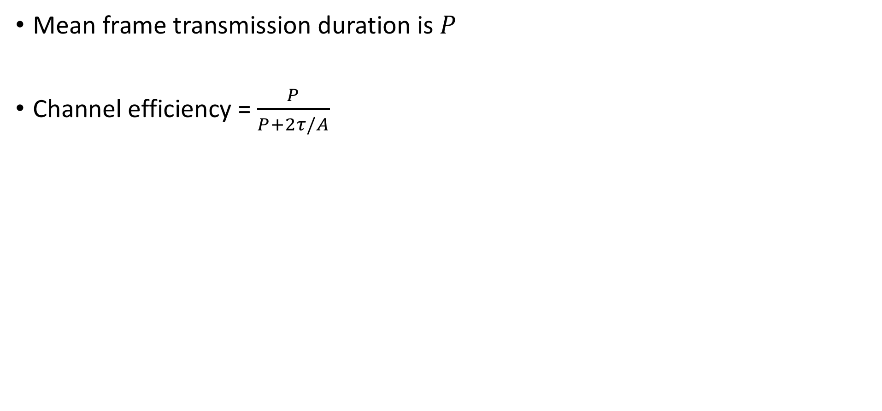
Ethernet Performance
Mean frame transmission duration is $P$
Channel efficiency = $\frac{P}{P+2τ/A}$
Image Source: Computer Networks, Tanenbaum

Slide 57
Can You Detect Collision over Wireless?
Wireless Signal
Fading – Attenuation is high, Signal strength drops as the signal propagates
Shadowing – Gets affected by shadowed textures, like wall
Multipath Propagation – Reflected signals may come from different directions
Additive Interference: Signals from multiple sources gets added up and interfere with the communication of a third device
Individual signals may not enough for interference
Interference range is different from the transmission range

Slide 58
Hidden Terminal Problem
Image Source: https://www.youtube.com/watch?v=X-H2tLesBUQ

Slide 59
Exposed Terminal Problem
Image Source: https://en.wikipedia.org/wiki/Exposed_node_problem

Slide 60
Wireless Scenario
Collision detection is not feasible for wireless
How will detect a data loss due to interference?
Sender transmits a DATA
Receiver sends an ACK
Assume the frame to be lost, if ACK is not received within a predefined timeout.

Slide 61
Virtual Carrier Sensing (VCS) – CSMA/CA
Request to Send (RTS)
Clear to Send (CTS)
Image Source: Asymmetric RTS/CTS for Exposed Node Reduction in IEEE 802.11 Ad Hoc Networks

Slide 62
Setting up Network Allocation Vector (NAV)
Image Source: https://community.arubanetworks.com/t5/Technology-Blog/Understanding-802-11-Medium-Contention/ba-p/232034

Slide 63
IEEE 802.11 Distributed Coordination Function (DCF)
Set n = 0 /*n denotes the round number*/
Use PCS (and VCS) to sense the channel
If the channel is busy, repeat 2
If the channel is idle for DIFS duration, transmit the frame, set timeout
If ACK received within timeout, Go to 1
If timeout, set CW_{min} = min (2xCW_{min}, CW_{max})
Set n = n+1
Set CW = random (0, CW_{min})
Wait for CW number of slots and go to 2

